Slide 1













COMPANY PROFILE
LYON Security Solutions (Pty) Ltd.
24 Gunners Circle, Epping Industria 1 Cape Town, South Africa
Reg No. 2017/064832/07 BBEE Level 1
2023
www.lyonsecurity.co.za

Slide 2









Table of Contents About Company Welcome Message Why Us
Vision & Mission Services Security Services
Industry Security 1
1 2
Table of
3
Contents
4 5
6
7
8
Industry Security 2 Cleaning Services
9
10 11
12
How We Work Meet The Team Our Contact

Slide 3









About
Company
Established to provide a professional guarding service that is reliable and cost-effective. LYON SECURITY SOLUTIONS has continued to forge its success based on building long-term client relationships & partnerships, combined with exceptional customer service delivery.
With over 25 years of industry expertise powering the company, Lyon Security places great importance on sound management, staff welfare, and working with clients who share these values.
We wholeheartedly believe that these are the key ingredients to providing a level of service that is unequaled, reliable, and trustworthy.
We have extended our services to offer our clients a professional high- quality cleaning service that may be combined with security solutions or utilized as a stand-alone service.
Lyon Security Solutions is a registered training service provider and we hold all our trainees to our high standards of operating, ensuring a generation of well-trained, reliable security officers to populate the security industry.
Accreditation:
PSIRA-Registered: 2744547
BBEE level 1

Slide 4


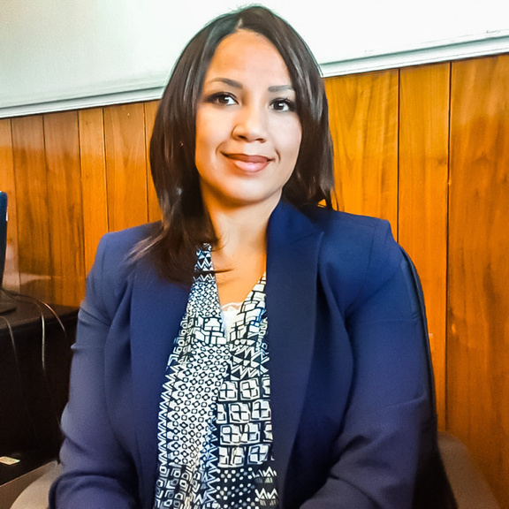







Cindy Beukes
Chief Executive Officer
Welcome
Message
Lyon Security Solutions were launched to empower females in the security industry as it is mostly a male-dominated industry. During these uncertain times, we want our clients to have peace of mind that their assets are protected. We value the safety of all mankind and continue to pray for our country and its people. We have a highly skilled and experienced management team that has a hands-on approach and provides the best value for money security guarding & cleaning services. Why wait, send us your request for a comparative quotation and join the team.
Employment Equity
Lyon aims to afford every team member the opportunity to develop and
make a meaningful contribution to the organization and the
community, to create a sense of unity and responsibility toward safety
and security with an emphasis on good hygiene.

Slide 5







Why Us
We recognize that the priority of every stakeholder in our company is to ensure that we continue to serve our customers with superior quality security and guarding service. To this end, we commit ourselves to
The establishment of an approach and or a suitable solution to
satisfy the needs and expectations of our customers.
Establishing, quantifying, and specifying the deliverables that will
meet these needs.
Selecting or contracting with the most suitably qualified and experienced
service providers to successfully realize the deliverables.
Selecting and using the most appropriate equipment, systems, and methods for the successful deliverables per intervention.
Progressively work with the Customer and Stakeholders to ensure the
realization of the milestones established per contract, up to and
including the conclusion of the contract.
Progressively measure the success factors of each order and take
corrective action where necessary
Communicate to all staff via regular meetings, inductions, and
Management Reviews of the objectives and targets of the Q.M.S.

Slide 6










Vision
& Values
Mission
Vision
To provide superior security solutions and cleaning services, Honesty, and transparency towards our clients, employees, suppliers, and partners. Integrity to honor our commitments.
Mission
We aim to meet the evolving security needs of our clients by providing personalized, hands-on, and high-quality security solutions and cleaning services that positively impact the client’s business performance and growth The safety & security of the client's staff, premises, and assets, as well as the general public, is our highest priority.
Values
As a company, we value honesty, integrity, professionalism, and mutual respect for our staff and clients. We hold ourselves accountable to our clients, staff, and partners by honoring our commitments, providing results and continually striving to provide the highest quality security & cleaning service.

Slide 7






Our
Services
Security Guarding
Security presents a unique set of challenges, which require skilled and professional management., We supply and manage fully PSIRA- registered, well trained security officers who are skilled in communication and customer service.
Cleaning Services
Utilize our cleaning service as a stand-alone service or combine it with our security solutions, We offer contract cleaning, office, public bathrooms, warehouses, and, commercial premises.

Slide 8








Security
Services
Security Solutions
Our primary focus is supplying and managing well-trained, registered security officers for the commercial, retail, hospitality, industrial, and residential sectors. We also recognize the importance of the front-of- house role and therefore ensure that our security officers provides a smart and efficient service to visitors and staff.
With our fully equipped control room and a complete Operations team, we can coordinate a consistent security service over multiple properties. We also assemble a management structure under a Key Account Manager to ensure that each site receives the highest quality of protection
Security Services
Access Control
Real Time Patrol Monitoring CCTV installation/On and Off site monitoring services Innovative Technology systems include.
Body cameras
Access control tech
and mobi patrol

Slide 9





Industry
Security
Retail Industry/Malls & Gated Communities
Lyon Security Solutions operates at the highest level in this security area, effectively identifying and controlling weaknesses in your business and implementing plans to combat those weaknesses.
We understand that patrons like to shop without the displeasure of being scrutinized by an obtrusive security officer, so we emphasize creating a comfortable shopping atmosphere while still maintaining a presence to deter any would-be thieves. Utilizing the Onguard biometric vehicle registration & Identification scanner system, our officers manage complete access control at all entry & exit points
Residential Industry
Possessions can be replaced but loved ones cannot! Security is a lifestyle and Lyon Security will partner with homeowners and Estate Managers to create this secure lifestyle.
Commercial & Industrial Industry
Should it be required, the security officers will play an important part in monitoring the movements of suppliers, deliveries (incoming and outgoing), workers, and anyone visiting your premises, providing optimum access and egress control to protect your business assets.

Slide 10








.
Hospitality Industry
We understand that everyone wants to be greeted at the front door of a Hotel with a smile and an open hand. We also understand that guests want to be assured that they will have a great time without worrying about their safety. At Lyon Security Solutions we want you to be able to approach security personnel who will be happy to go out of their way to direct and assist your guests. Lyon Security Solutions will provide Hospitality Security Officers who will look after your clients whilst making sure that your Hotel is a safe place. All our security officers are screened and vetted, impeccably presented, and have been trained to meet our exacting standards of communication, public relations, and customer service.
Value Added Services
Value Added Service as follows: Free Security Needs Consultation Free Risk Surveys
Free assessments
Investigations
Free Cost-effective Quotation

Slide 11











Cleaning
Services
Cleaning Services
We have added Lyon Cleaning Services as another facet to our growing company profile. Customers not only get best-in-class security but also best-in-class cleaning and maintenance services all on one invoice (if so desired). Lyon Cleaning Services staff are professionally trained to tackle all cleaning requirements from small to large-scale office, retail, property, and commercial entities. Lyon Cleaning Services provides only the best cleaning tools, equipment, and cleaning
agents to ensure that any scenario is
managed according to the customer
requirements

Slide 12












How
We Work
The Lyon difference is in how we operate and approach security. We go beyond simply providing security personnel, but prefer a more personalized touch so our clients have direct access to our management
Although we pride ourselves on our teamwork, we know that ultimately responsibility rests with management. All our managers are on call 24/7 and make regular announced and unannounced visits to the sites they operate. Building and maintaining long term client partnerships.
Accessibility is paramount to Lyon Security Solutions and this sets us apart from our competitors. Communication between clients and management should be transparent.

Slide 13















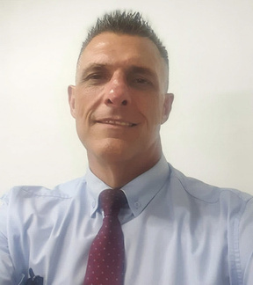







Meet
With Management
C
O
i
n
d
y
-
C
E
B
e
u
k
u
s
V
r
a
n
G
n
a
g
e
M
a
G
M
r
a
a
n
-
M
a
r
k
L
a
g
d
e
n
-
cindy@lyonsecurity.co.za
mark@lyonsecurity.co.za

Slide 14










LYON
Security Solutions (Pty) Ltd
Connect With
Us!
Our
Contact+27 (0) 21 300 6895
+27 (0) 21 300 6895
admin@lyonsecurity.co.za
www.lyonsecurity.co.za
24 Gunners Circle, Epping Ind 1
Cape Town, South Africa

